Slide 1

Cheat Detection in Online Examinations
Team Details
Team Number : A21
SI No. | Student Name | USN | Roll No. | Division
1 | Devaraj Hireraddi | 01FE21BCI044 | 137 | F
2 | Nitin Nagaral | 01FE21BCI043 | 136 | F
3 | Pratham Shirol | 01FE21BCI018 | 117 | F
4 | Kushalagouda Patil | 01FE21BCI061 | 151 | F
5 | Girish Dongrekar | 01FE21BCI047 | 140 | F
Guide: Prof. Guruprasad Konnurmath

Slide 2

Problem Statement
Develop an online exam cheat detection model, that is used for monitoring, identity verification, gadget detection and eye movement tracking.

Slide 3
Objectives
Develop a robust algorithm to detect multiple persons in webcam feed.
Implement a model to recognize unauthorized electronic devices.
Implement a model to track the eye movement.
Integrate an alert mechanism for prompt notification of cheating behavior.
Optimize the model for real-time processing and scalability.

Slide 4
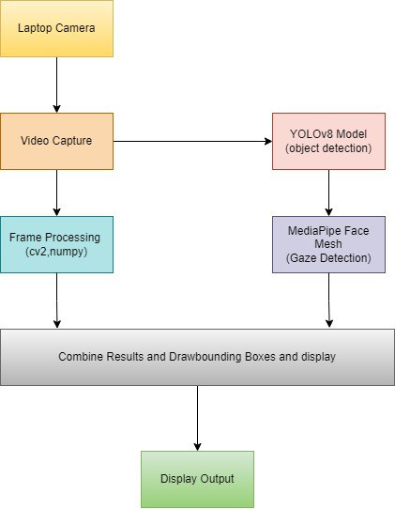
System Diagram

Slide 5

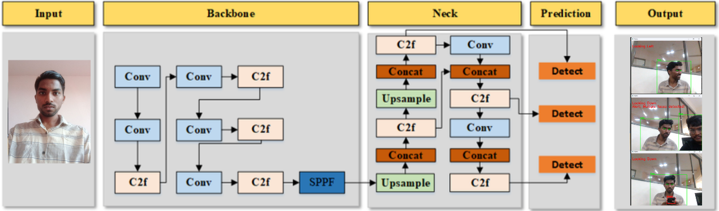
Model Architecture

Slide 6
Data Description
The custom dataset used for training the YOLOv8 model consists of 850 images. These images contain various scenarios with people, including Person using unauthorized electronic devices such as mobilephone, laptop, head phones, person looking down,right side,left side etc. Each image has been annotated in roboflow to indicate the presence of persons and gadgets.
Image Count: 850 images
Annotations: Bounding boxes around persons, gadgets
Epochs : 100

Slide 7



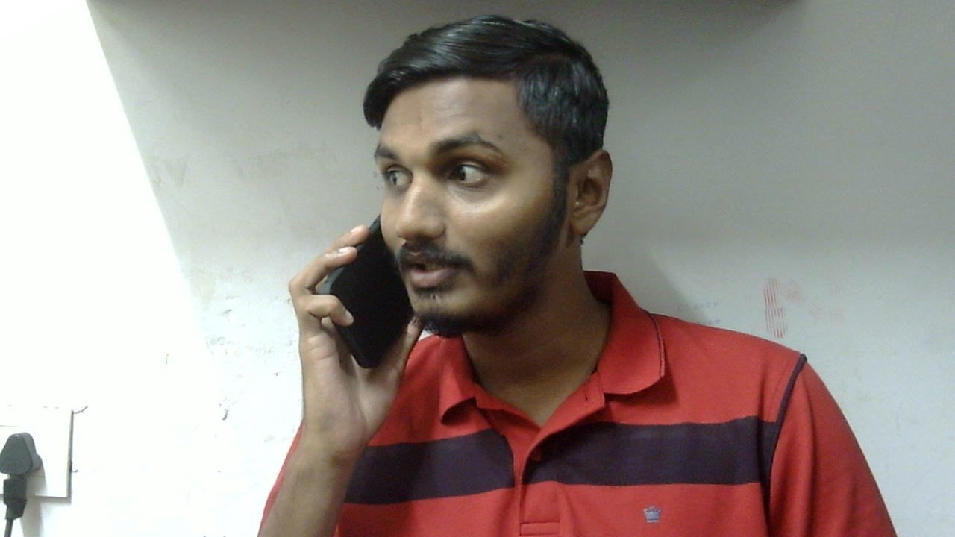
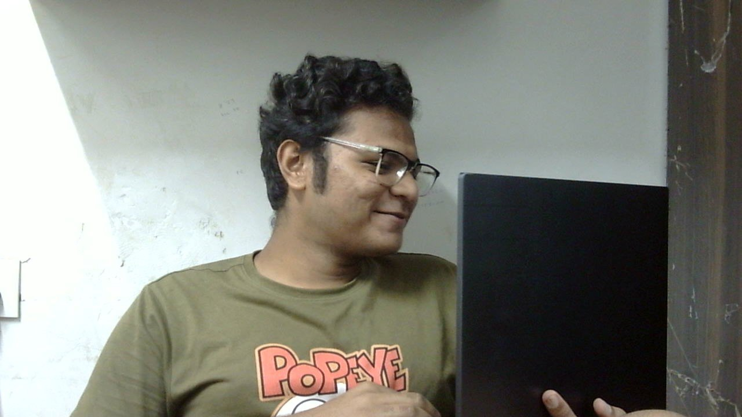
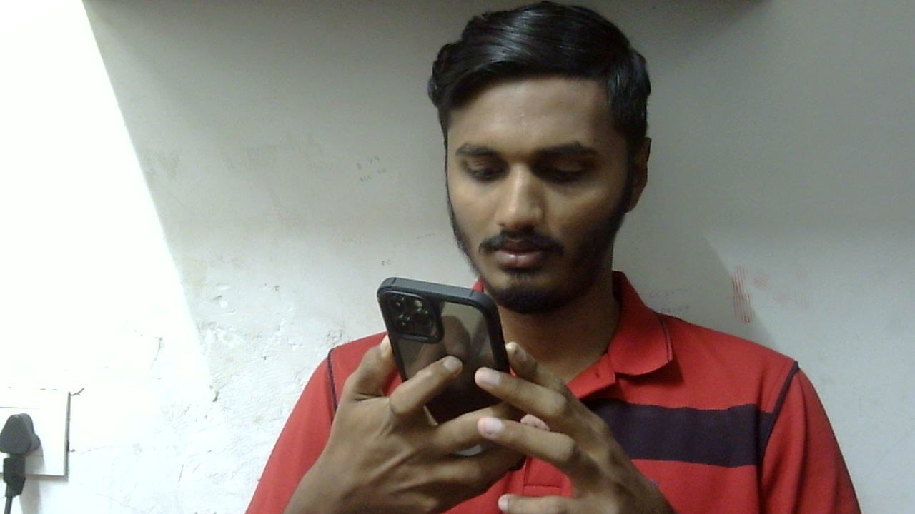
Data Sample

Slide 8
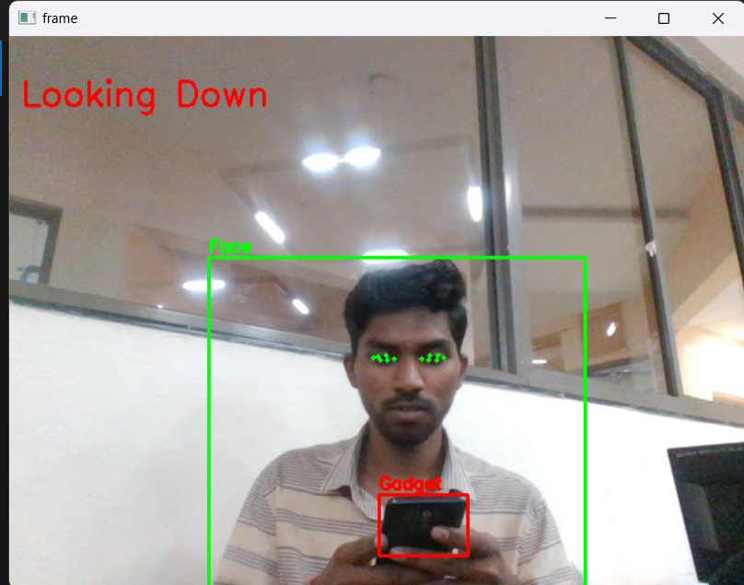
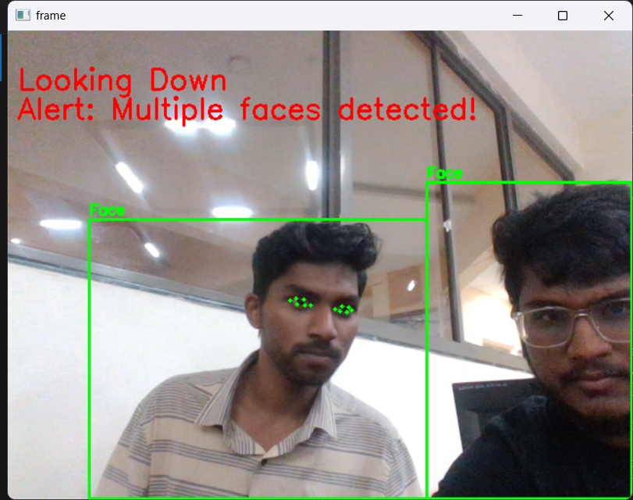
Results

Slide 9
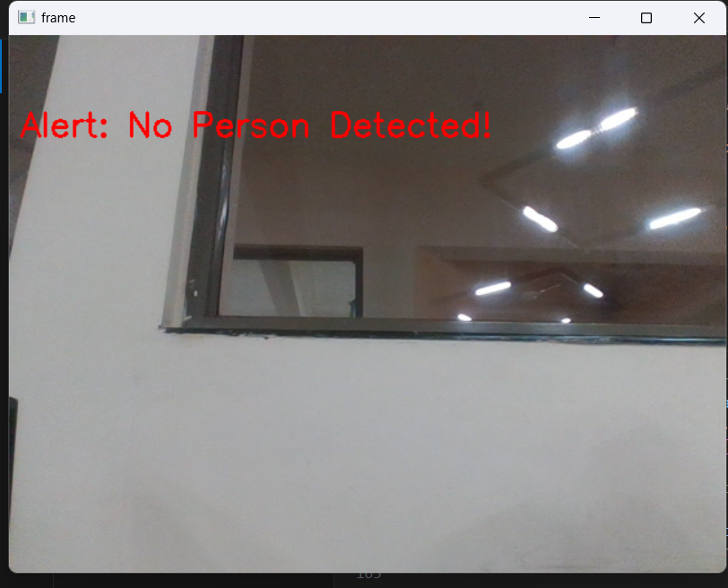
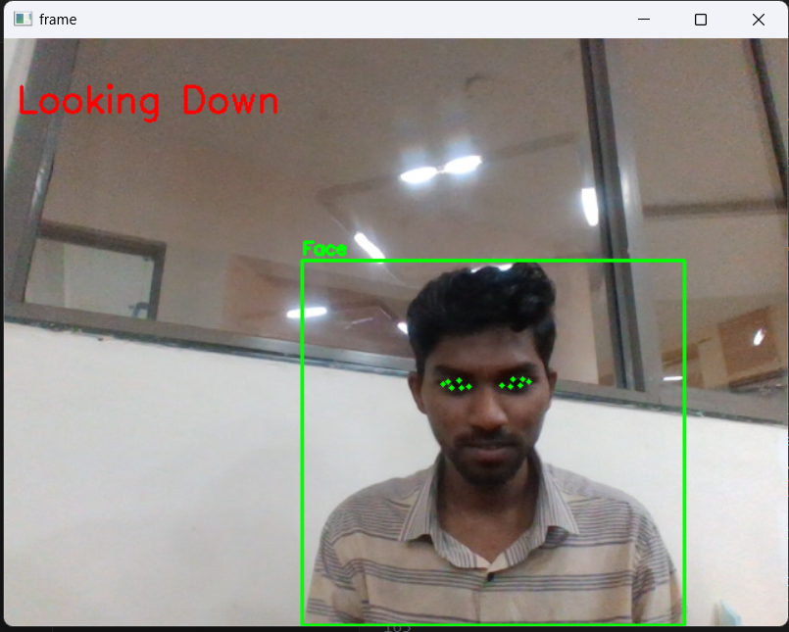
Results

Slide 10
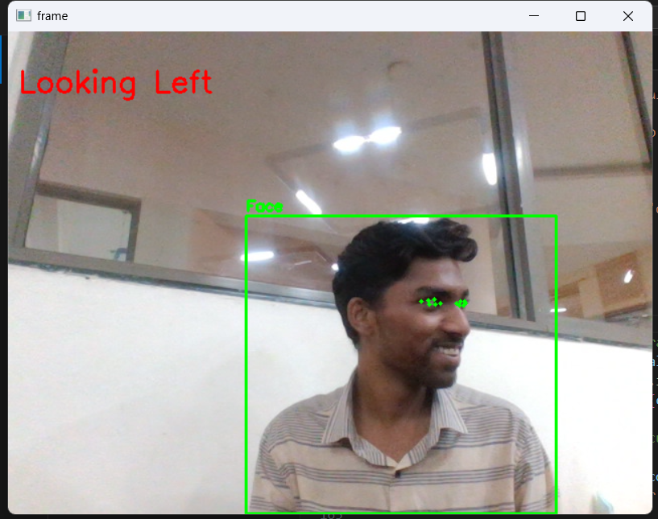
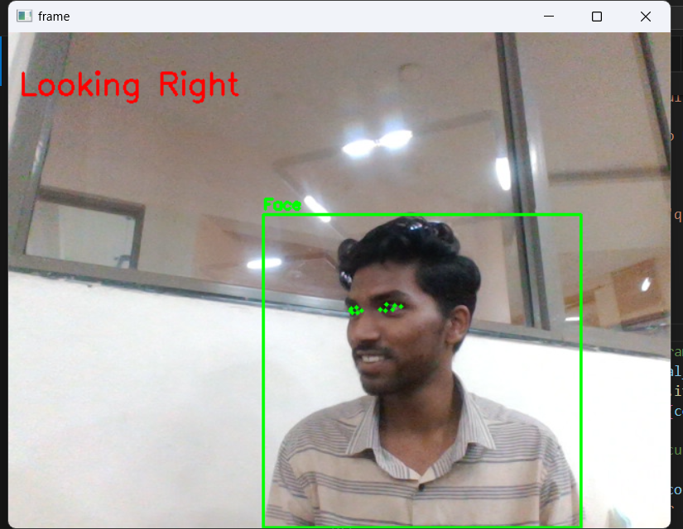
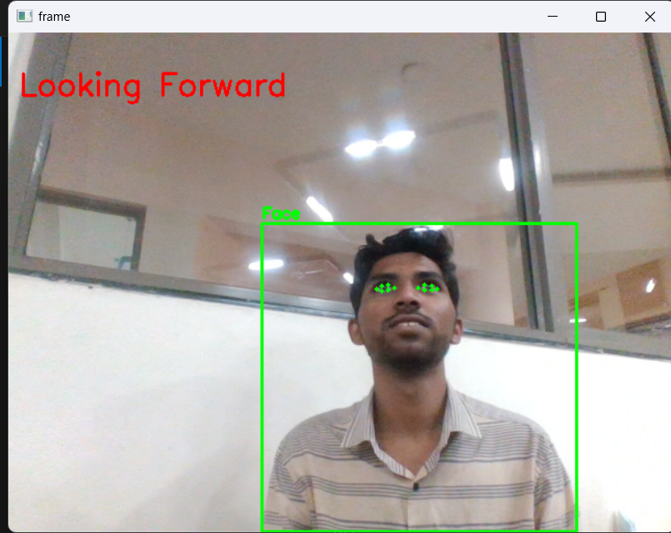
Results

Slide 11
Results
Thank You

